Slide 1



















Edited and presented by :
Marwa Al-Hadi
Lecture 4: Data collection (sensor)

Slide 2
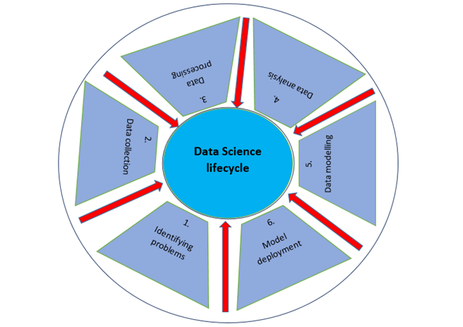
Identify your problem
What is your problem?
2

Slide 3
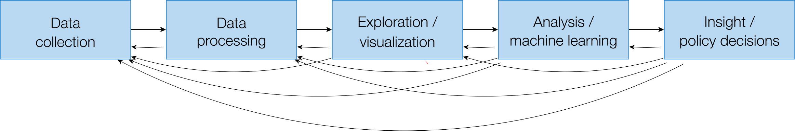
Data Science
Ex:IoT
3

Slide 4
Types of Data Sources
Primary Data:
Data collected directly from the source.
Examples: Surveys, experiments, IoT sensors.
4

Slide 5
Introduction to IoT and Data Science
Internet of Things (IoT) refers to interconnected devices that collect, transmit, and process data through the internet.
5

Slide 6
Introduction to IoT and Data Science
Internet of Things (IoT) refers to the network of physical devices connected to the internet, enabling them to collect and exchange data.
6

Slide 7
Introduction to IoT and Data Science
Examples:
wearable devices (e.g., fitness trackers),
and industrial sensors.
7

Slide 8
Introduction to IoT and Data Science
IoT in Data Science
IoT generates vast amounts of real-time data.
These datasets can be used for predictive modeling, analytics, and decision-making in areas like healthcare, agriculture, and smart cities.
8

Slide 9
Steps in IoT Data Collection
1. Identify the Purpose
Define the problem or objective for collecting IoT data.
Examples:
Monitor heart rate using wearable devices.
Measure soil moisture levels for precision agriculture.
Track energy consumption in smart homes.
9

Slide 10
Steps in IoT Data Collection
2. Choose IoT Devices
Select devices based on the data required:
Sensors: Measure physical parameters (e.g., temperature, humidity, light, motion).
Actuators or Arduino ..etc.: Respond to data by taking actions (e.g., turning on a fan).
Wires or wireless or Bluetooth for connection
10

Slide 11
Arduino
Basically Arduino is Microcontroller.
Microcontroller is microprocessor with memory, RAM and some other peripheral connected with it.
The Arduino Uno is a microcontroller board based on the ATmega328 . The ATmega328 has Flash memory of 32 KB. It also has 2 KB of SRAM and 1 KB of EEPROM
Notes:
Flash- Where program is stored.
SRAM-Static Random Access Memory ( sketch creates and manipulates variables when it runs )
EEPROM- Electrically Erasable Programmable Read-Only Memory ( memory whose values are kept when the board is turned off )

Slide 12
Arduino
**Flash- Where program is stored.
**SRAM-Static Random Access Memory ( sketch creates and manipulates variables when it runs )
**EEPROM- Electrically Erasable Programmable Read-Only Memory ( memory whose values are kept when the board is turned off )
Notes:
Flash- Where program is stored.
SRAM-Static Random Access Memory ( sketch creates and manipulates variables when it runs )
EEPROM- Electrically Erasable Programmable Read-Only Memory ( memory whose values are kept when the board is turned off )

Slide 13
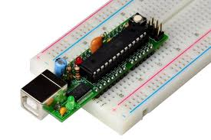
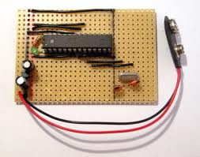
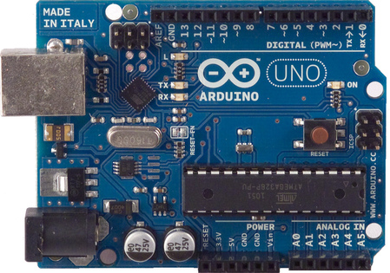
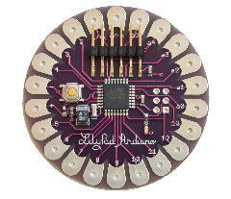
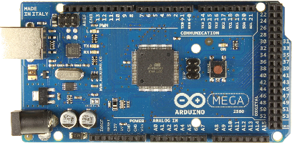
Different types of Arduino
Boarduino Kit
Arduino LilyPad
DIY Arduino
Arduino Uno
Arduino Mega 2560

Slide 14
Arduino uno
What does it have?
14 Digital In/Out pins
6 Analog Inputs
A USB Connection
A Power Jack
Reset Button
On-board LED
SCL/SDA pins (Serial Clock/ Serial Data pins)

Slide 15
Arduino uno
What does it have?
In short, it contains everything needed to support the microcontroller; simply connect it to a computer with a USB cable or power it with a AC-to-DC adapter or battery to get started.

Slide 16
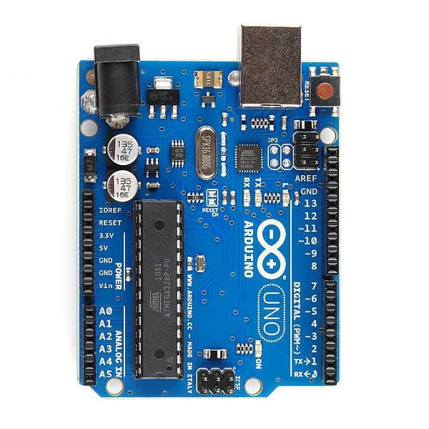
USB
(to Computer)
PWR IN
RESET
SCL\SDA
(I2C Bus)
POWER
5V / 3.3V / GND
Digital I\O
PWM(3, 5, 6, 9, 10, 11)
Analog INPUTS

Slide 17
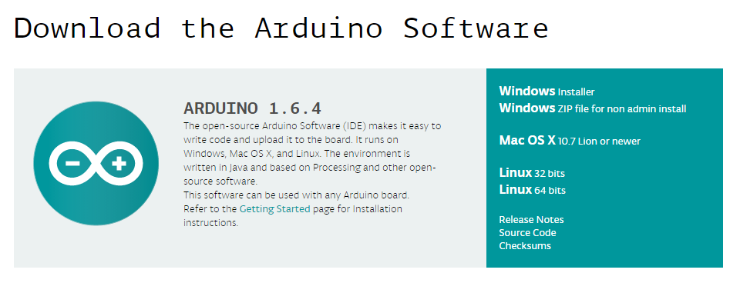
How to code in arduino
You need to download Arduino IDE (Integrated Development Environment).
Arduino IDE is available for all Mac, Windows.and Linux.

Slide 18
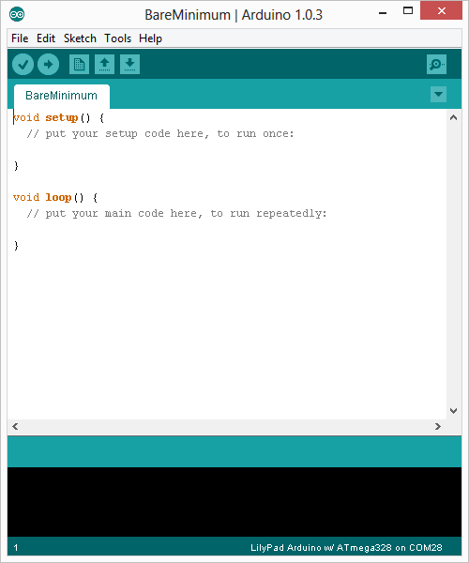
How to code in arduino
Once you have downloaded and installed/extracted the folder, you can directly run Arduino.exe, which will take you to its IDE.
The IDE will look like the shown screenshot.
error & status messages

Slide 19
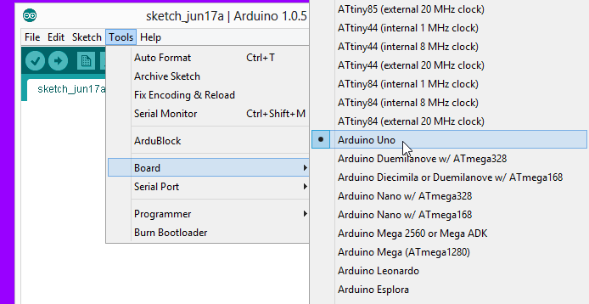
Program your arduino
Before you start programming, double check that correct board is selected under Tools → Board.
Now, you can start playing with Arduino.

Slide 20
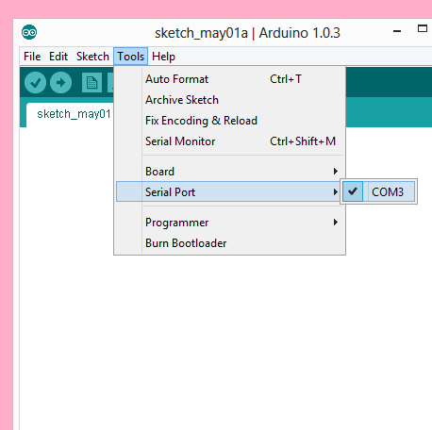
Program your arduino
The Arduino Uno can be programmed with the Arduino software. Select "Arduino Uno from the Tools > Board menu (according to the microcontroller on your board).
All the peripheral connected with Computers are using Serial Port.
You can check port for Arduino Uno in Device Manger.

Slide 21
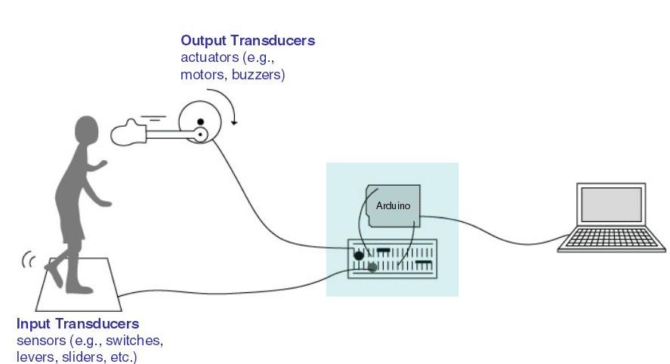
Input vs output

Slide 22
6 Major concepts
digitalWrite()
analogWrite()
digitalRead()
If (statements) / Boolean
analogRead
Serial Communication

Slide 23
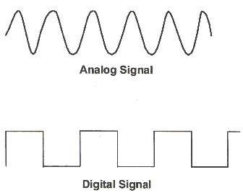
Analog vs digital
Microcontrollers are digital devices – ON or OFF. Also called – discrete.
Analog signals are anything that can be a full range of values.
5 V
5 V
0 V
0 V

Slide 24
Steps in IoT Data Collection
3. Set Up Connectivity
IoT devices use protocols to communicate data:
Wires: connect using set of wires.
Wi-Fi: Common for home devices.
Bluetooth: Short-range communication.
LoRaWAN: Long-range, low-power communication for industrial applications.
24

Slide 25
Steps in IoT Data Collection
4. Data Acquisition
Collect data from IoT sensors in real-time.
Use wires, APIs, MQTT, or HTTP protocols to transfer data to a storage system.
25

Slide 26
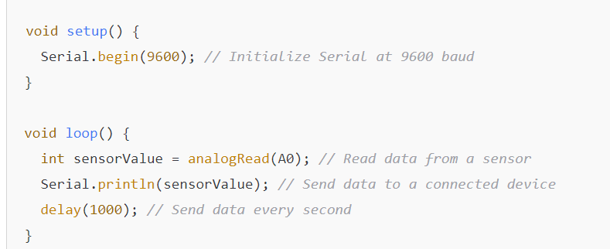
Steps in IoT Data Collection.. Using wires
26

Slide 27
Steps in IoT Data Collection.. Using MQTT
Using MQTT (Message Queuing Telemetry Transport):
MQTT is
a lightweight messaging protocol designed for IoT applications,
enabling devices to send data to a broker that routes it to subscribers.
27

Slide 28
Steps in IoT Data Collection ...Using MQTT
How It Works:
Devices publish data to MQTT broker under specific topics (e.g., sensor/temperature(
Subscribers: receive the data and store it e.g., a database application
28

Slide 29
Steps in IoT Data Collection.. Using MQTT
Key Components:
Publisher: The device sending data.
Broker: that manages message distribution.
Example : self-hosted or cloud-based, e.g., HiveMQ, AWS IoT
Subscriber: The system receiving and processing the data..
29

Slide 30
Steps in IoT Data Collection.. Using MQTT
Example :
A soil monitor sends data to an MQTT broker.
A storage service subscribes data and logs the readings in a database.
30

Slide 31
Steps in IoT Data Collection.. Using APIs
Using APIs
1. Understand the Use Case:
Collecting data from a public API.
Sending sensor data to a cloud API for real-time monitoring.
Fetching device configurations or updates from a remote server.
31

Slide 32
Steps in IoT Data Collection.. Using APIs
1. Understand the Use Case:
2. Basic Steps for Data Collection.
Setup IoT Devices Use IoT hardware (e.g., Raspberry Pi, ESP8266, ESP32, Arduino) equipped with Wi-Fi or other communication capabilities.
Program the device to interact with APIs.
Use Appropriate Communication Protocol HTTP/HTTPS for communication.
Configure API Access: request methods (GET, POST, etc.), and response formats (JSON, XML).
32

Slide 33
Example of soil moisture sensor
our soil moisture sensor: when we stick it in the soil, it checks how much water's in there. The probe has these two metal bits that measure how easily electricity can flow through the soil. More water means easier flow, less water means it's a bit tougher. The sensor then tells us what's up with the soil moisture. It's like having a little meter to check if your plants need a drink!
33

Slide 34
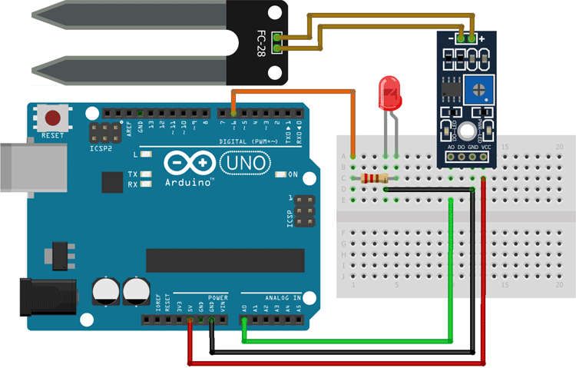
Example of soil moisture sensor
34

Slide 35
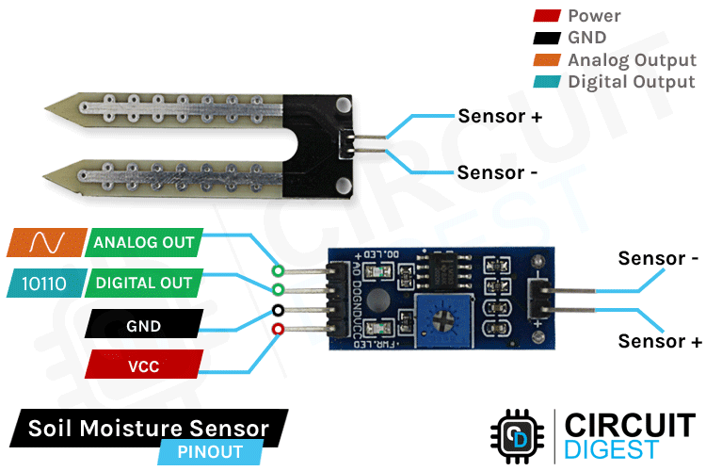
Example of Soil Moisture Sensor with Arduino
35

Slide 36
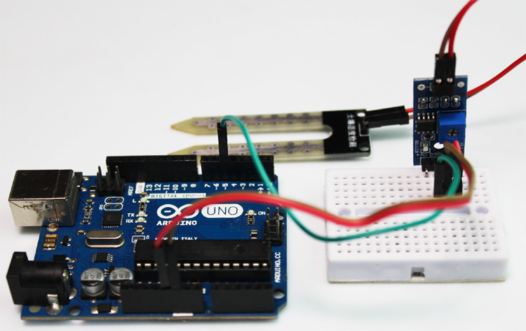
Example of soil moisture sensor
Components and supplies
Arduino UNO R3 - Made in italy
Breadboard - 830 contacts
Capacitive Soil Moisture Sensor
36

Slide 37
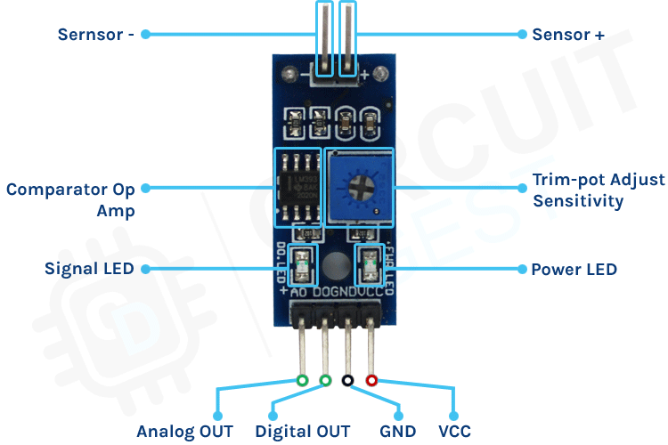
Example of soil moisture sensor
37

Slide 38
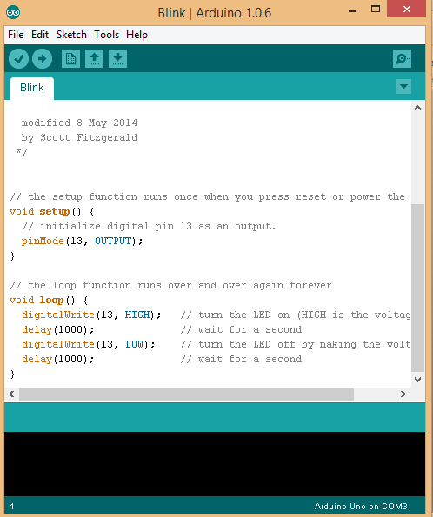
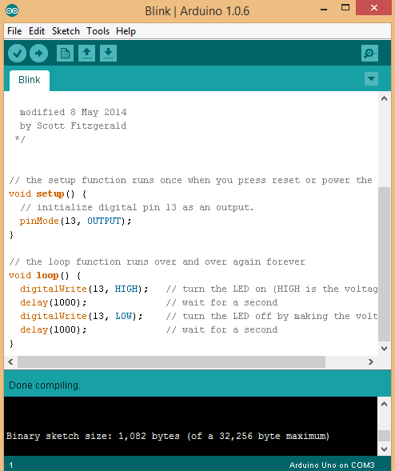
Upload
Compile
Status Message

Slide 39
Code Arduino soil moisture sensor code
// Moisture Sensor Arduino Code
//By Circuitdigest
#define ledPin 6
#define sensorPin A0
void setup() {
Serial.begin(9600);
pinMode(ledPin, OUTPUT);
digitalWrite(ledPin, LOW);
}
void loop() {
Serial.print("Analog output: ");
Serial.println(readSensor());
delay(500);
}
// This function returns the analog data to calling function
int readSensor() {
int sensorValue = analogRead(sensorPin); // Read the analog value from sensor
int outputValue = map(sensorValue, 0, 1023, 255, 0); // map the 10-bit data to 8-bit data
analogWrite(ledPin, outputValue); // generate PWM signal
return outputValue; // Return analog moisture value
}
39

